Slide 1
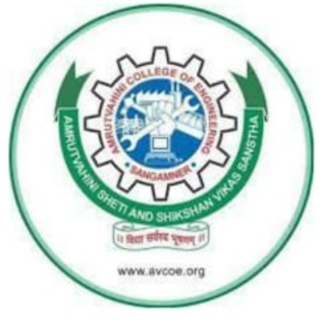

AMRUTVAHINI COLLEGE OF ENGINEERING
SANGAMNER..
Topic:- Variable Valve Timing (VVT)
Presented by:-Telore Dnyaneshwar
Guided by :Prof.D.M.Nibe
Roll No:- 2264

Slide 2
Introduction to Variable Valve Timing (VVT)
Variable Valve Timing (VVT) is a technology used in internal combustion engines to optimize the timing of valve operation. It improves engine performance, efficiency, and reduces emissions by adjusting the timing of valve opening and closing based on engine speed and load.

Slide 3
Need for (VVT) System:-
Traditional engines use fixed valve timing, which limits efficiency.
At low rpms, fixed timing causes inefficient combustion and fuel wastage.
At high rpms, it restricts airflow, reducing power output.
VVT dynamically adjusts valve timing based on engine speed and load.

Slide 4
Working Principle of VVT:-
VVT systems adjust the position of camshafts relative to the crankshaft. This allows for changes in the valve opening and closing timing. Electronic control units (ECUs) monitor engine parameters and adjust the camshaft position using hydraulic or electric actuators.

Slide 5
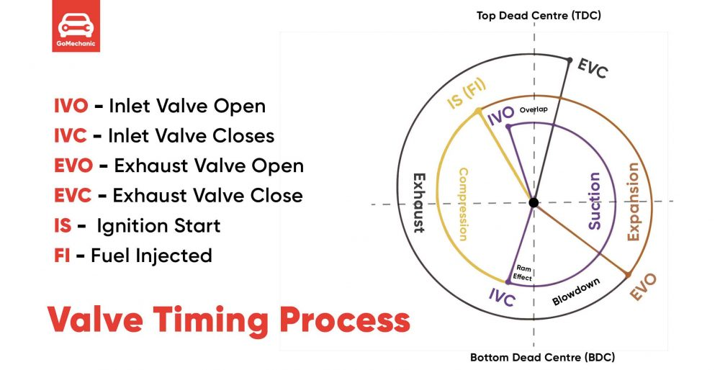
Valve Timing Diagram:-

Slide 6
Types of VVT Systems
Cam phasing (most common)adjusts the timing of the camshaft but does not change the valve lift.
Example: Toyota’s VVT-I, BMW's VANOS.
Cam-changing system suses multiple camshaft profiles and switches between them based on engine speed.
Example: Honda VTEC.
Variable valve lift systems changes both valve timing and lift height, allowing more precise air intake control.
Example: BMW valvetronic.

Slide 7
Advantages of VVT
- Improved engine performance and power output
- Enhanced fuel efficiency
- Reduced emissions and environmental impact
- Better adaptability to different driving conditions
- Smoother engine operation

Slide 8
Disadvantages of VVT
- Increased complexity of the engine system
- Higher manufacturing and maintenance costs
- Potential reliability issues with electronic and hydraulic components

Slide 9
Applications of VVT
- Widely used in modern gasoline and diesel engines
- Automotive industry for both performance and economy vehicles
- Applicable in motorcycles and marine engines
- Hybrid and plug-in hybrid powertrains

Slide 10
Conclusion
VVT has revolutionized modern internal combustion engines by providing an optimal balance between performance and efficiency. By adjusting valve timing in real-time, it enhances fuel economy, increases power when needed, and reduces emissions to meet environmental standards. As automotive technology evolves, VVT continues to play a crucial role in improving engine performance and sustainability.

Slide 11
Thank
You

